Slide 1

DESKTOP PERSONAL ASSISTANT
MASTER OF COMPUTER APPLICATION
BY
Krishna Singh, Md. Gulsher Alam
Singh Yogesh Kumar Vijay Kumar
Under the esteemed guidance of
Mr. Hirdesh Sharma(Assis. Prof.)

Slide 2
INTRODUCTION
This project is based on windows system and provide personal assistant using voice recognition. This program includes the functions and services of: set alarm, music player service, checking weather, Google searching engine, Wikipedia searching engine.
This project is originated from a popular application from Windows called “Cortana”. This is very interesting, easy going and convenient, with wide real world usage and large developing potential. For instance, the voice assistance is very useful for personal assistants, direction guides or driving, helps among the disabled community, and so on.
This system is designed to be used efficiently on desktops. Personal assistant software improves user productivity by managing routine tasks of the user and by providing information from online sources to the user.

Slide 3
OBJECTIVE
Save your time.
Voice is reputed to be four times faster than a written search.
Fetch data from different API.
Automate the work.
Hand-free Operation.

Slide 4
PURPOSE
Being capable of voice interaction.
In this ever-evolving digital world where speed, efficiency, and convenience are constantly being optimized, it’s clear that we are moving towards less screen interaction.

Slide 5
SOFTWARE REQUIREMENT
Windows 7(32-bit) or above.
Python 2.7 or later.
Chrome Driver.
Any Text Editor.

Slide 6
HARDWARE REQUIREMENT
Pentium-pro processor or later.
RAM 512MB or more.
MIC(Working condition).
Speaker.

Slide 7
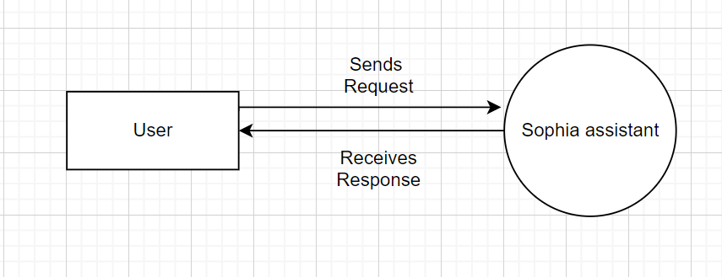
Data Flow Diagram
0 level

Slide 8
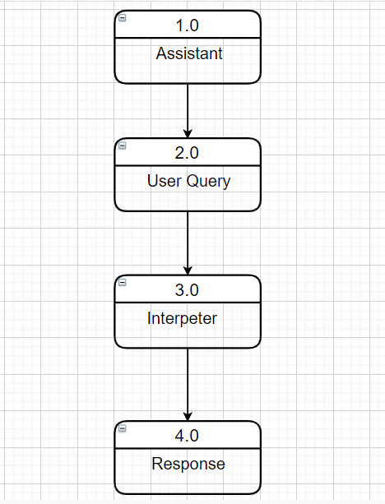
Data Flow Diagram
Level 1

Slide 9
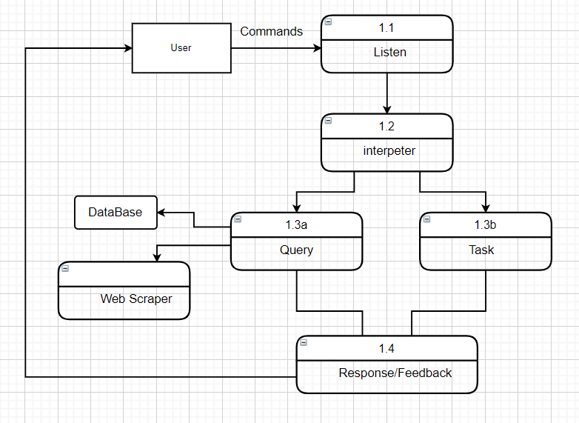
Data Flow Diagram
Level 2

Slide 10
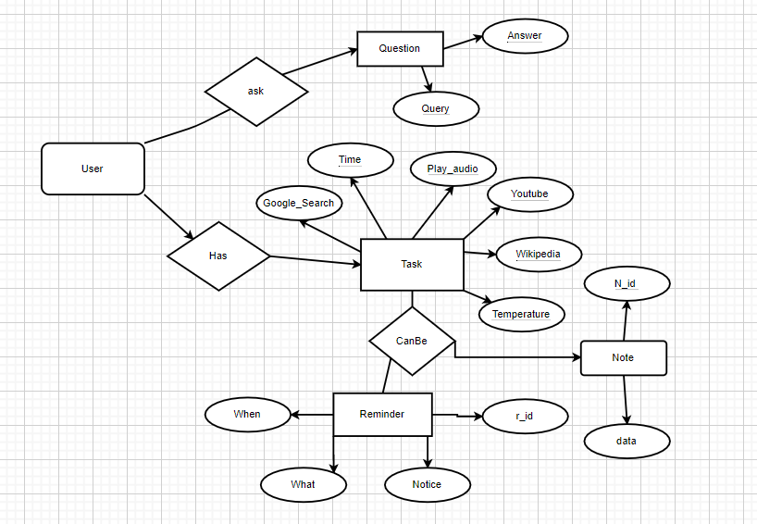
ER DIAGRAM

Slide 11
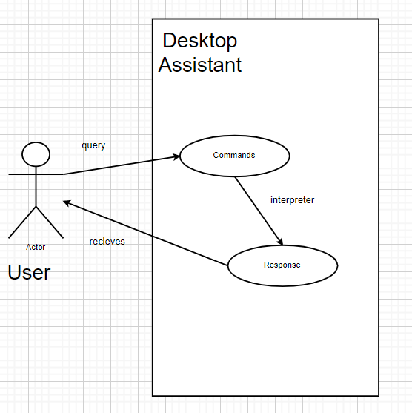
Class Diagram

Slide 12
THANK YOU!

